Slide 1
CISSP
Network Review

Slide 2
Basic Concepts– IP Addresses (IP V4)
IP Addresses
IP version 4
32 bit longs made up of 4 -8 bit numbers( Called OCTETS) between 0 and 255
127.0.0.1 Your workstation
255.255.255.255 Broadcast
IP addresses are assigned by classes.
Class A IP address is one that begins with 0.__.__.__ up to 126.__.__.__ These can have approximately 16 million hosts.
Class B Are from 128.0.__.__ to 191.255.__.__ and can have 65,000 hosts
Class C are from 192.0.0._ to 223.255.255._ and can have 127 hosts
Class D are from 224-247 These are reserved for multicasting.
Class E 248-255 Reserved for experimental use.
More Details
http://www.networkcomputing.com/netdesign/ip101.html
http://en.wikipedia.org/wiki/IP_address

Slide 3
Basic Concepts – MAC Address
6 byte (48 bit) hexadecimal number uniquely identifies NIC
1st 3 bytes identify the vendor
Not routable
NICs use a MAC address to filter irrelevant packets
When a packet is received, the NIC verifies that the destination MAC address matches the MAC address of the network card or is a broadcast MAC address
This process offloads analyzing packets from IP to NIC thus Reduces CPU utilization on the computer

Slide 4
Basic Concepts What is a packet?
On the Internet, the network breaks an e-mail message into parts of a certain size in bytes. These are the packets. Each packet carries the information that will help it get to its destination -- the sender's IP address, the intended receiver's IP address, something that tells the network how many packets this e-mail message has been broken into and the number of this particular packet. The packets carry the data in the protocols that the Internet uses: Transmission Control Protocol/Internet Protocol (TCP/IP). Each packet contains part of the body of your message. A typical packet contains perhaps 1,000 or 1,500 bytes.

Slide 5
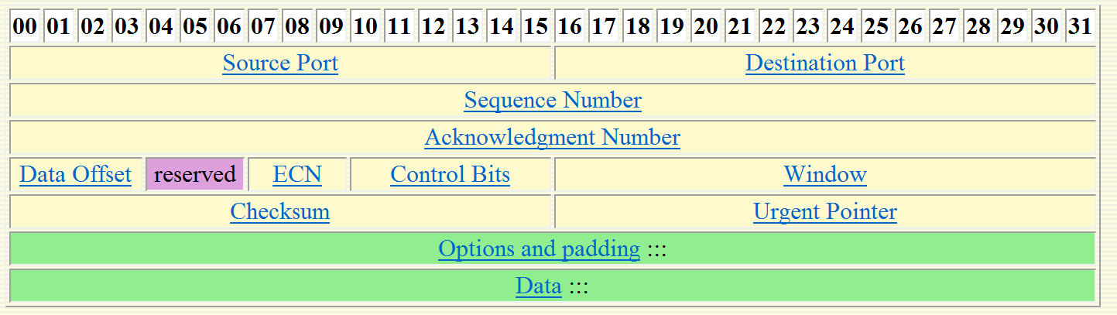
Packet Structure -TCP Headers

Slide 6
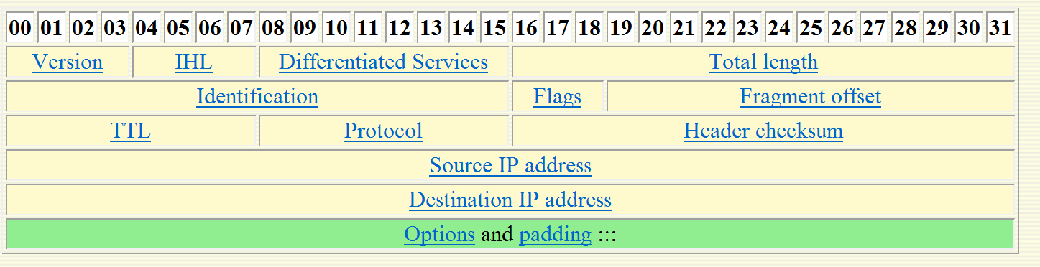
Packet Structure - IP Headers

Slide 7
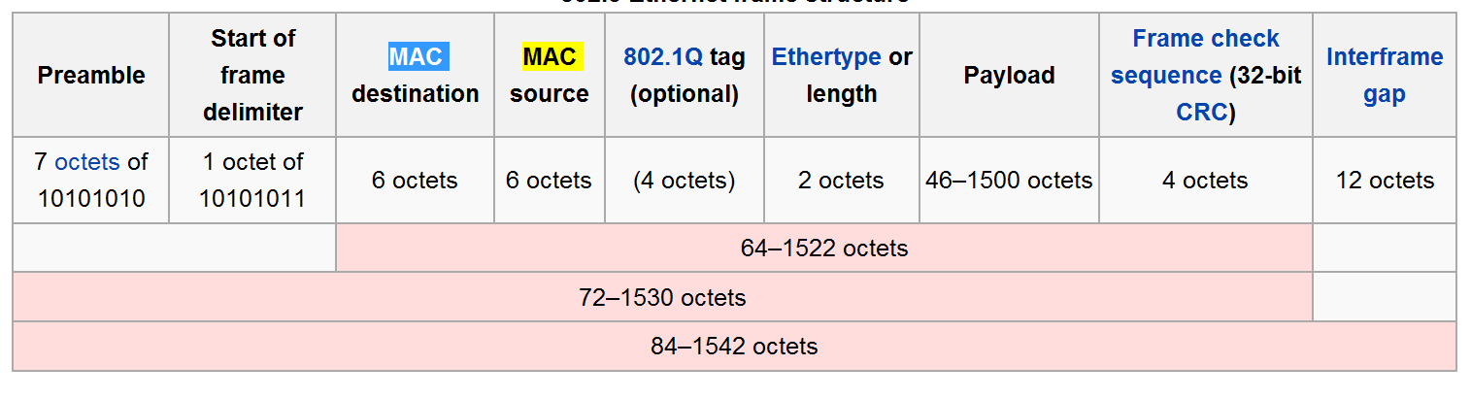
Packet Structure - Ethernet Header

Slide 8
Basic Concepts - Network Hardware
Network Interface Card: - A Network Interface Card, often abbreviated as NIC, is an expansion board you insert into a computer so the computer can be connected to a network. A NIC handles many things
  Signal encoding and decoding
  Data buffering and transmission
  Media Access Control
  Data Encapsulation: building the frame around the data.
Hub: - A hub is used to connect computers on an Ethernet network.
  An active hub behaves like a repeater.
  A switching hub is another word for a switch.
  An intelligent hub supports protocols such as SNMP and allows admin functions.
Repeater: - Boosts signals in order to allow a signal to travel farther and prevent attenuation. Attenuation is the degradation of a signal as it travels farther from its origination. Repeaters do not filter packets and will forward broadcasts. Both segments must use the same access method, which means that you can't connect a token ring segment to an Ethernet segment. Repeaters can connect different cable types. Repeaters work at the physical layer of the OSI model.
  Amplifier Repeaters amplify all incoming signal
  Signal – regenerating repeaters (also called an intelligent repeater) reads the signal and creates an exact duplicate.

Slide 9
Basic Concepts - Network Hardware (cont.)
Switch - A switch prevents traffic jams by ensuring that data goes straight from its origin to its proper destination, with no wandering in between. Switches remember the address of every node on the network, and anticipate where data needs to go. It only operates with the computers on the same LAN. It cannot send data out to the internet, or across a WAN. These functions require a router.
Note: Layer Three switches used to be called brouters, but this term is seldom used anymore
Switches can significantly reduce network traffic.

Slide 10
Basic Concepts – Hardware/ Gateway
Gateway - Often used as a connection to a mainframe or the internet. Gateways enable communications between different protocols, data types and environments. This is achieved via protocol conversion, whereby the gateway strips the protocol stack off of the packet and adds the appropriate stack for the other side.

Slide 11
Basic Concepts – Hardware/Routers
Router - A router is similar to a switch, but it can also connect different logical networks or subnets and enable traffic that is destined for the networks on the other side of the router to pass through. Routers can connect networks that use dissimilar protocols. Routers also typically provide improved security functions over a switch. Unroutable protocols can't be forwarded. Routers work at the network layer of the OSI model.
Static
  Mostly replaced by dynamic
  Manual configuration
  Manual updates
  Can’t compensate for changing environments
Dynamic
  Use an Interior Gateway Protocol (IGP) to communicate with each other
Default gateways

Slide 12
Basic Concepts – Hardware/Bridges
Bridge – Divides a network in order to reduce traffic problems. A bridge can also connect unlike network segments (ie. token ring and ethernet). Bridges create routing tables based on the source address. If the bridge can't find the source address it will forward the packets to all segments. Bridging methods:
  Transparent – connects networks of the same type also called learning
  Source-Route – used with token rings
  Translational – connects different types of networks also called heterogeneous
  Encapsulating
    Packages frames of one format into the format of another
    Faster than translation
  http://en.wikipedia.org/wiki/Bridging_(networking)
Bridges and switches work at the Data Link layer of the OSI model, making them "Layer Two" devices. Both read MAC addresses to create a MAC address table, which allows the switches to help send frames to their proper destination. You see very few bridges in today's networks, especially with the advent of Layer Three switches.
Two common bridge routing algorithms
  Spanning tree - Where two bridges are used to interconnect the same two computer network segments, spanning tree is a protocol that allows the bridges to exchange information so that only one of them will handle a given message that is being sent between two computers within the network.
  Source routing -allows a sender of a packet to partially or completely specify the route the packet takes through the network. In contrast, in non-source routing protocols, routers in the network determine the path based on the packet's destination.
More depth on routing algorithms http://computer.howstuffworks.com/routing-algorithm.htm/printable
.
Bridges work at the Data Link Layer of the OSI model

Slide 13
Network Utilities
IPConfig
Ping
Tracert
Netstat
Nslookup
Arp ping (NOT a default utility)
• Arp
• Route –displays and modifies entries in local IP table http://technet.microsoft.com/en-us/library/bb490991.aspx
• Nbtstat –trouble shooting Netbios names)
DIG (Domain Information Groper) UNIX only
Mtr –combines ping and tracert
netsh
net

Slide 14
OSI Model
Application Layer: This layer interfaces directly to and performs common application services for the application processes.
Presentation Layer: The Presentation layer relieves the Application layer of concern regarding syntactical differences in data representation within the end-user systems.-POP, SMTP, DNS, FTP, Telnet
Session Layer: The Session layer provides the mechanism for managing the dialogue between end-user application processes.-NetBIOS
Transport Layer: This layer provides end to end communication control.-TCP
Network Layer: This layer routes the information in the network.-IP, ARP, ICMP
Data Link-This layer describes the logical organization of data bits transmitted on a particular medium. It is also divided into two sub layers: the Media Access Control layer (MAC) and the Logical Link Control layer (LLC).-SLIP, PPP
Physical
This layer describes the physical properties of the various communications media, as well as the electrical properties and interpretation of the exchanged signals. In other words this is the actual NIC, Ethernet Cable, etc.
More Details http://www.webopedia.com/quick_ref/OSI_Layers.asp
http://searchnetworking.techtarget.com/generic/0,295582,sid7_gci1147329,00.html#

Slide 15
IP Addresses and Subnet Masks
The subnet mask is a 32 bit number that is assigned to each host to divide the 32 bit binary IP address into network and node portions.
The first number of a subnet mask must be 255 the remaining 3 numbers can be 255, 254, 252,248, 240, 224.
To apply a subnet mask you convert both IP and subnet to binary and Binary AND The two.

Slide 16
IP Subnetting Continued
Each device that connects to the network must have a unique IP address.
Each subnet must have its own unique network ID
All devices on a given subnet must have the same subnet mask.
RFC 1918 defines the non-routable private IP address ranges:
  10.0.0.10 to 10.255.255.255
  172.16.0.0 to 172.31.255.255
  192.168.0.0 to 192.168.255.255

Slide 17
CIDR
Classless Inter-Domain Routing (CIDR)
Implemented in 1993
Alleviates problem of too few addresses
Allows you to use variable-length subnet masking (VLSM) to create addresses beyond IPv4 classes
Group addresses together in CIDR blocks

Slide 18
CIDR address
Written in the standard 4-part dotted decimal
Followed by /N
  N is a number from 0 to 32
  N is the prefix length
Prefix is the number of bits (starting at the left of the address) that make up the shared initial bits

Slide 19
APIPA
Private IP Addressing (APIPA)
169.254.0.0 network
Windows OSes, Windows Server 2000 forward, autogenerate APIPA addresses
Client systems that are configured for automatic IP address assignment / dynamic IP assignment will attempt to use DHCP to make a request for an IP address lease for a given network. When the DHCP server is unavailable the service on the client will automatically configure the system with an APIPA IP address in the 169.254.0.1 through 169.254.255.254 address range with a subnet mask of 255.255.255.0.

Slide 20
IPv6
Internet Protocol version 6 (IPv6)
Uses 128-bit addresses
Provides 2¹²⁸ addresses
Eight 4 character hexadecimal fields
Write as eight groups of four numbers in hexadecimal notation separated by colons
  Replace group of all zeros by two colons
  Only one :: can be used per address
  Can drop leading zeros in a field
  All fields require at least one number, except for the :: notation

Slide 21
IPv6 - Continued
IP V 6 utilizes a 128 bit address (instead of 32) and utilizes a hex numbering method in order to avoid long addresses such as 132.64.34.26.64.156.143.57.1.3.7.44.122.111.201.5. The hex address format will appear in the form of 3FFE:B00:800:2::C for example.

Slide 22
IPv6 - Continued
Network portion indicated by a slash followed by the number of bits in the address that are assigned to the network portion
  /48
  /64
Loopback address is a localhost address
IPv6 loopback address can be written as ::/128
fe80::/10 is equivalent to the IPv4 169.254.0.0

Slide 23
IPv6 - Continued
Link/Machine-local
  IPv6 version of IPv4’s APIPA
  Self-assigned using Neighbor Discovery process
  Starts with fe80::
Site/Network-local
  IPv6 version of IPv4 private address
  Begins with FE
  C to F for the third hex digit—FEC, FED, FEE, or FEF

Slide 24
IPv6 - Continued
Network devices autoconfigure when connected to a routed IPv6 network
Process
  Performs stateless address autoconfiguration
  Sends link-local multicast router solicitation request for configuration parameters
  Router responds with a router advertisement packet containing network configuration parameters flags

Slide 25
IPv6 – Continued – Router Flags
Managed Address Configuration Flag (M flag)
  When set to 1, device should use DHCPv6 to obtain a stateful IPv6 address
Other Stateful Configuration Flag
(O flag)
  When set to 1, device should use DHCPv6 to obtain other TCP/IP configuration settings

Slide 26
IPv6 – Continued – Router Flags
M flag is 0 and O flag is 1
  Device should use its stateless autoconfiguration IPv6 address
  Device should retrieve other configuration parameters from the DHCPv6 server
  DHCPv6 stateless addressing
M flag 1 and O flag is 0
  Device should obtain an IPv6 address from a DHCPv6 server
  Doesn’t obtain other TCP/IP configuration parameters
  Combination is rarely used

Slide 27


Videos
Intro to IP V 6 http://www.youtube.com/watch?v=2wa7y3W2DI0

Slide 28
Security Protocols
22 SSH
23 Telnet
88 Kerberos Authentication
137,138,139 NETBIOS
161 and 162 are SNMP
223 Certificate Distribution Center
443 HTTP –HTTP over SSL/TLS
464 Kerberos Change/Set Password
465 SMTP secure
500 ISKAMP IKE (Internet Key Exchange)
543 Kerberos login
544 Kerberos remote shell
636 ldap protocol over TLS/SSL
749 Kerberos admin

Slide 29
Ports to Know
20 & 21- FTP (File Transfer Protocol) For transferring files between computers. Port 20 is for data 21 for control
22 – SSH & secure FTP
23-Telnet Used to remotely log on to a system. You can then use a command prompt or shell to execute commands on that system. Popular with network administrators.
25 SMTP (Simple Mail Transfer Protocol) Send email.
43-WhoIS A command that queries a target IP address for information.
53- DNS (Domain Name Service) Translates URL’s into Web Addresses
69 - TFTP
80-HTTP (Hyper Text Transfer Protocol) Display web pages
88- Kerberos Authentication
109- POP 2
110-POP3 (Post Office Protocol Version 3)Retrieve email.
137-138, 139 NetBIOS
161 – SNMP (and 162)
179 - BGP
194-IRC (Internet Relay Chat)Chat Rooms
220 – IMAP
389 LDAP
443 – HTTPS
445 – Active Directory, SMB
464 – Kerberos change password
465- SMTP over SSL
636 – LDAPS (SSL or TLS)
ICMP (Internet Control Message Protocol)These are simply packets that contain error message, informational messages, and control messages no specific port

